Slide 1
OVERCROWDED HOSPITAL SOLUTIONS FOR HAMILTON
OVERCROWDED HOSPITAL SOLUTIONS FOR HAMILTON

Slide 2
WHAT IS OVERCROWDING
Happens when there is not enough supplies to meet the flow of patients going in and out of the hospital

Slide 3
OVERCROWDING
CAUSES
Poorer health care
Longer wait times
Miscommunication
Workplace stress

Slide 4
CURRENT SOLUTIONS TO OVERCROWDING
eHealth Ontario
HQOntario Wait Times
More funding
Adoption of Walk in Clinics and Urgent Care Centres

Slide 5
HOW TO IMPROVE
The systems currently in place are supported by government funding and large databases. Doing research we realized we would need a completely new idea to solve this problem

Slide 6
NEW IDEA
Help guide patients to receive the right care at the right care centre

Slide 7
PROBLEM STATEMENT
Create a simple web app that directs patients where to go and get care

Slide 8

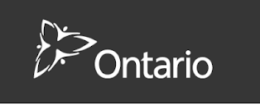

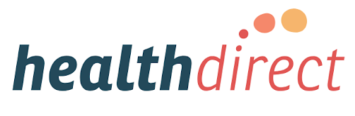
RESOURCES

Slide 9
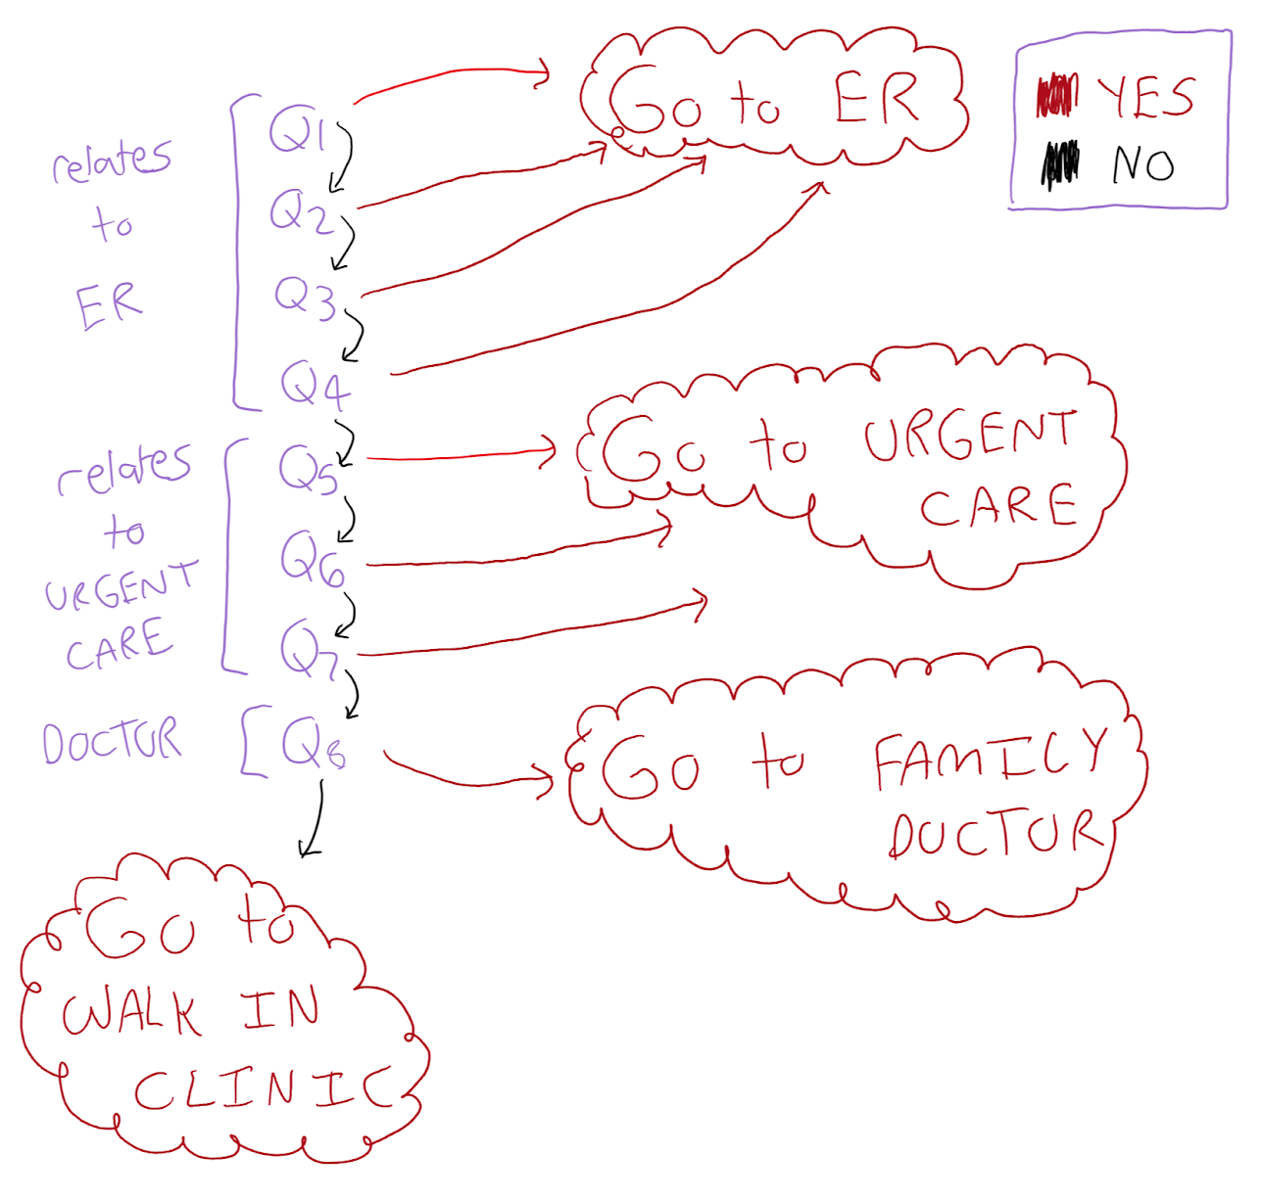
QUESTION LAYOUT

Slide 10
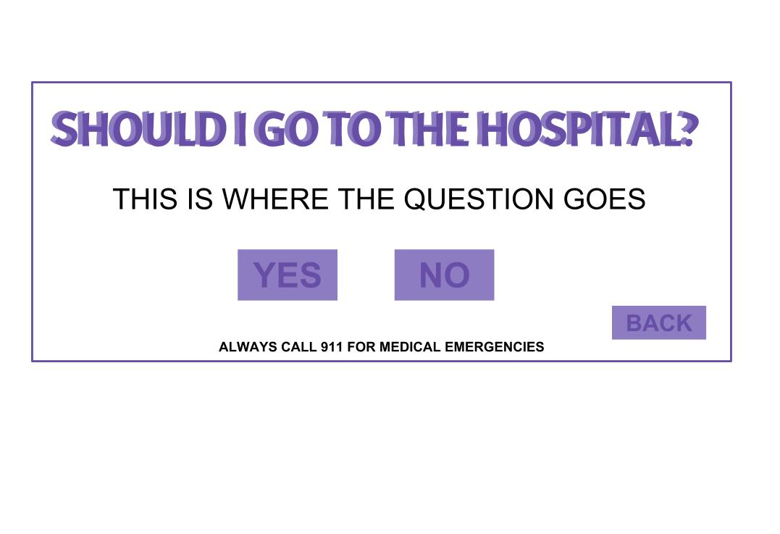
LAYOUT

Slide 11
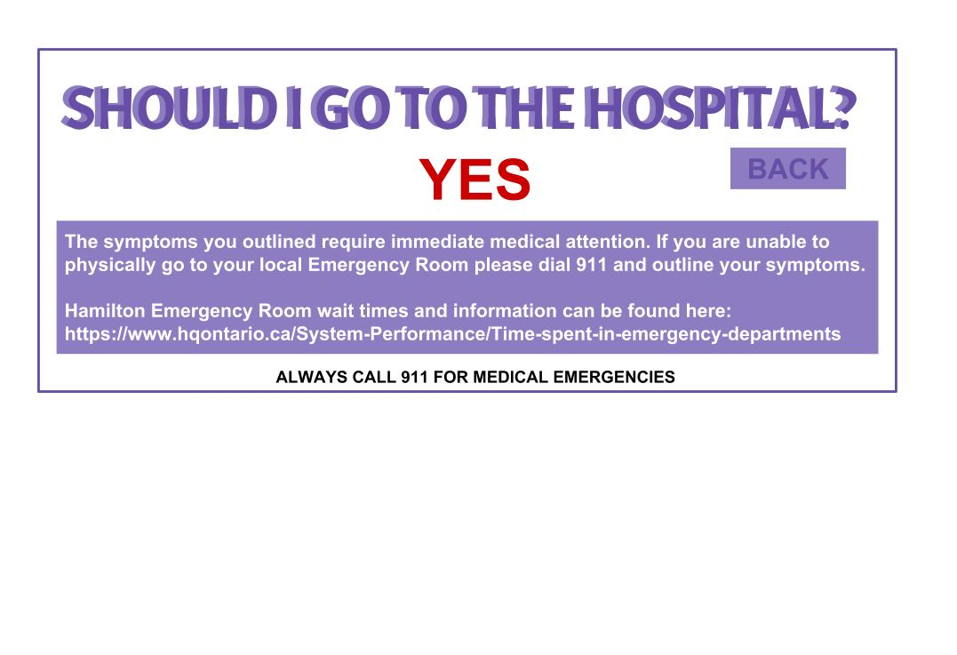
LAYOUT

Slide 12
DEMO
DEMO

